Slide 1


Welcome!
Inclusion Works INsider Summit
February 2026

Slide 2






INsider Summit Housekeeping
Session Help
All attendee microphones are muted.
Use the Q&A feature to communicate with Disability:IN or presenters.
You may need to reboot your computer or try logging out & back in to resolve any technical issues.
CART
English captions are available on-screen.
Captioning in additional languages available via StreamText link provided in the meeting materials.
ASL Interpretation
American Sign Language is provided on screen.
Asking Questions
Q&A will be available in the panel sessions.
Due to timing and the number of participants, we may not be able to answer all questions.
Reach out to your IW Consultant if needed.
Session Recordings
Sessions are being recorded.
An email will be sent with access and viewing instructions after the summit.
New! SHRM Credits
SHRM recertification credits are approved for this event.
To receive credit, attend each session live and fill out the feedback survey which will be sent after each day of the Summit.

Slide 3




Today’s Agenda Wednesday, February 18
10:00 Opening Keynotes: Baptist Health & Tripadvisor
10:45 Unseen, Not Unsupported: Accommodating Employees with Chronic Illness and Non-Apparent Disabilities
12:00 Shift by Shift: What it Takes to Create Accessible Workplaces for Hourly Employees
1:00 Space to Breathe: Building and Managing Sensory Rooms that Work
*all times EST

Slide 4

Opening Keynotes
The BRIDGE Program: A High-Impact Model for Hiring and Supporting Neurodiverse Talent in Healthcare
Empowered Minds & Abilities @ERG Evolution & Impact at Tripadvisor Group
Fred Mathieu, Employee Experience Consultant, Baptist Health
Sara Jeong, Creative Manager, Design and Empowered Minds & Abilities @ERG Co-Lead, Tripadvisor
Moderator:
Cara Pelletier, Vice President, Inclusion Works, Disability:IN

Slide 5
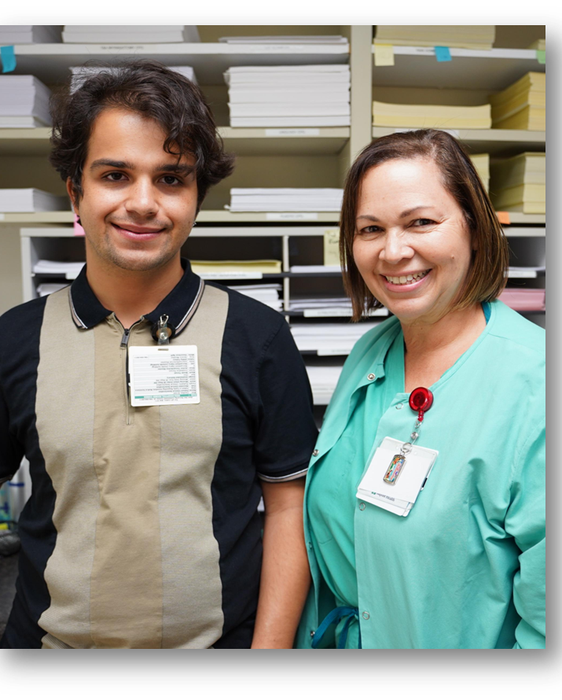
The BRIDGE Program
Fred Mathieu, MHA, MS

Slide 6

BRIDGE HIRES…
Meet the core competencies and values required of Baptist Health employees
Bring unique skills, approaches and perspectives to the workplace
Are accountable for performing the functions of the job for which they are hired
Are engaged and want to be productive members of their department
Do not negatively impact productivity
ALIGNED WITH OUR VALUES
At Baptist Health, we provide compassionate, high-quality care where everyone’s talents and unique abilities are valued. We are committed to providing opportunities for individuals of all abilities.
Inclusive Recruitment Strategies: 20+ community partners that support individuals with disabilities Expanded partnerships into Broward and Palm Beach counties
Interviewing and Selection: Customize job descriptions for candidates Mentoring day with the job coach and the hiring leader Flexible assignments as either part-time or full-time
Onboarding and Retention: Job coaches assist new employees with completing onboarding requirements Job coaching to support successful employment relationships
Resources to Foster Success Job Coaches Leader Training HR, EXC, and Leave and Disability Departments Leader and Team Onboarding

Slide 7
The BRIDGE Process
Building Room for Individuals with Disabilities to Gain Employment
The BRIDGE program enables Baptist Health to streamline candidate identification, training, and hiring practices and increase the number of persons with disabilities we hire.
Identify
Mentor
Hire
Train
Support
Baptist Health will identify open opportunities and assess if job carving is needed to employ persons with disabilities.
Candidates attend a Mentoring Day, an onsite job orientation and interview with their future Baptist Health leader, and are accompanied by a job coach.
Successful candidates are offered a position by a designated Recruiter assigned to focus on BRIDGE hires.
New employees receive job training. All employees working with BRIDGE hires will receive Disability Sensitivity Awareness Training.
Ongoing support is provided
via job coaches and the Employee Relations, Workplace Health and Employee Experience teams.

Slide 8
Mentoring Day and Job Coaches: Supporting Candidates, Leaders and Employees
Creates meaningful exposure and confidence for candidates Mentoring Day gives participants the chance to explore real roles, build workplace skills, and experience belonging in a supportive environment.
Strengthens employee readiness and long term success Job coaches provide guided training, structured feedback, and on the job support that helps employees learn tasks, build independence, and grow in their roles.
The program tackles structural barriers neurodiverse candidates face in traditional hiring processes.
Builds a culture that benefits the entire organization These supports ensure candidates feel welcomed and employees feel equipped, reinforcing our commitment to disability inclusion and sustainable hiring practices.

Slide 9
Powering Success
Hiring Leaders – Collaborate with leaders committed to opening opportunities to individuals with disabilities.
Community Partners – Strengthen our talent pipeline through strategic relationships organizations that serve individuals with disabilities.
Education and Training– Provide training through partnerships with universities and community organizations
Engagement and Retention – Host activations designed to connect employees, families, leaders, and partners to celebrate progress and build belonging.
Just Say YES Campaign – Create awareness and understanding allowing leaders and staff to see individuals with disabilities as employees and co-workers.
Ongoing Support – Human Resources, Employee Experience and Connection and Workplace Health teams support successful employment experiences.
Abilities Business Resource Group – Engaged team members who power our mission through advocacy, support, and awareness for individuals with disabilities.

Slide 10



Getting Started
Commit
Sustain
Pledge to hire persons with disabilities in your organization– one to three departments
Cultivate a welcoming environment for persons with disabilities at your organization
Foster leader confidence and capability in leading persons with disabilities
Engage and mentor employees who have disabilities
Execute
Communicate the expectations
Review and report to Stakeholders quarterly progress and adjust actions as needed
Say YES to scheduling interviews/mentoring days for open positions
Identify specific opportunities to hire persons with disabilities
Say YES to converting full-time positions to part -time positions when requested

Slide 11
Thank you!

Slide 12

Empowered Minds + Abilities@ ERG Evolution & Impact at Tripadvisor Group

Slide 13
Events
In partnership with Wheel the World
In partnership with Anise Health & Asian@ ERG
In partnership with Disability:IN
In partnership with Disability:IN
Creating Content for All: Disability Inclusive Marketing and Communications
Destigmatizing Mental Health in the Workplace
Accessible Travel & Industry Impact
Neurodiversity in the Workplace

Slide 14
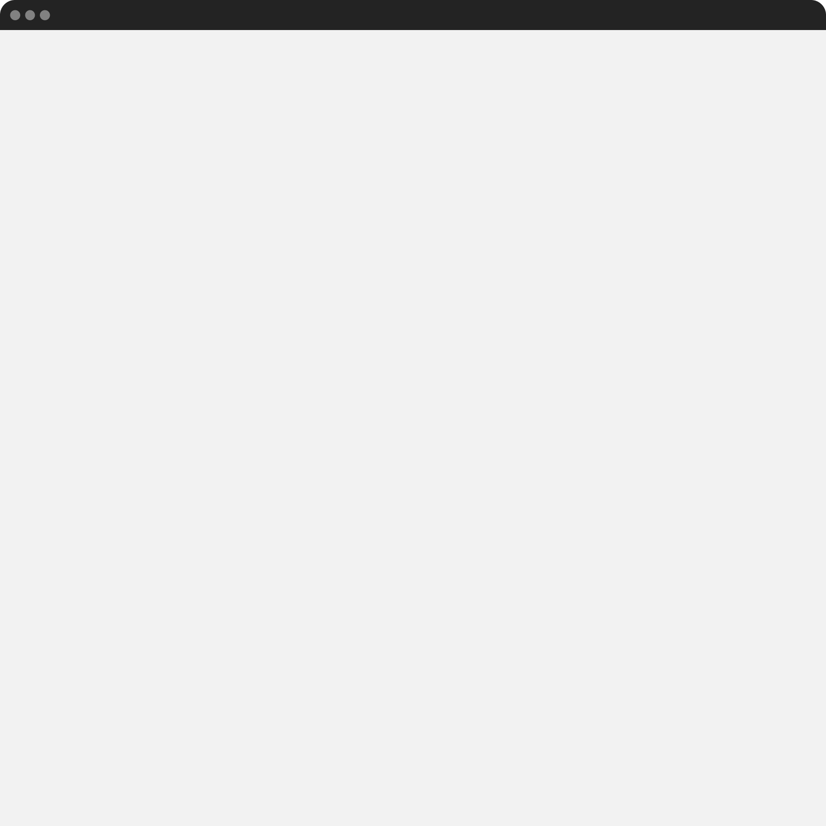
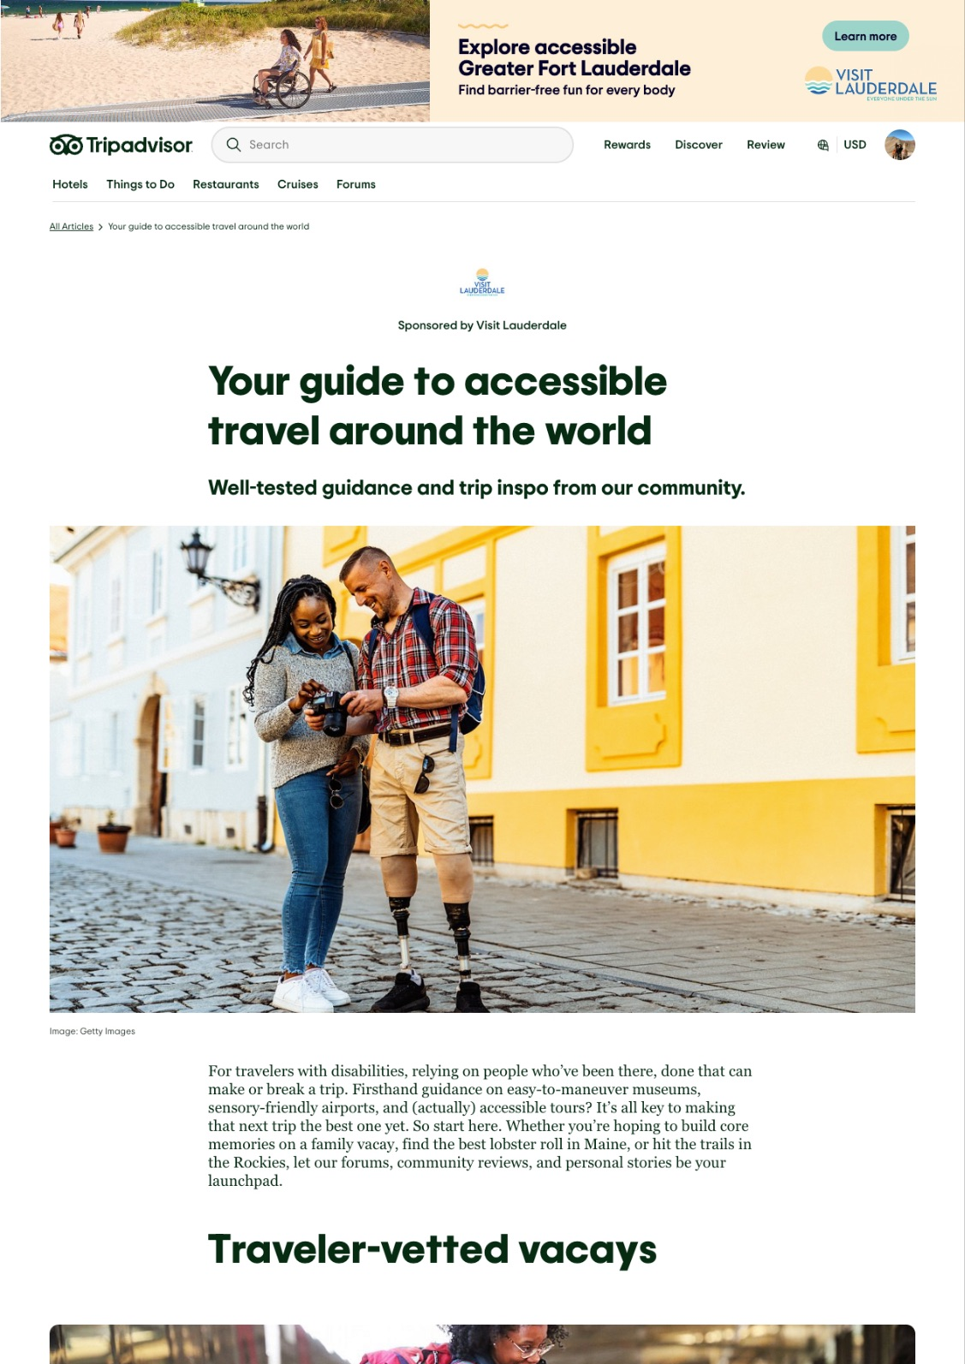
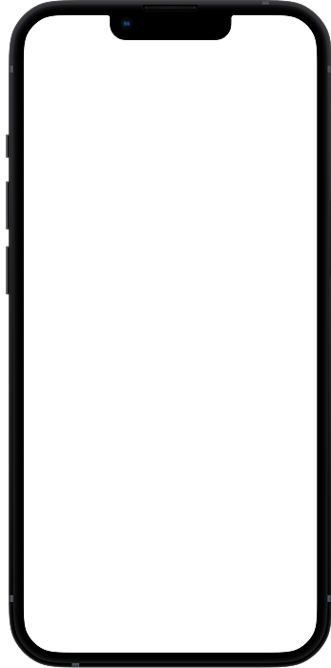
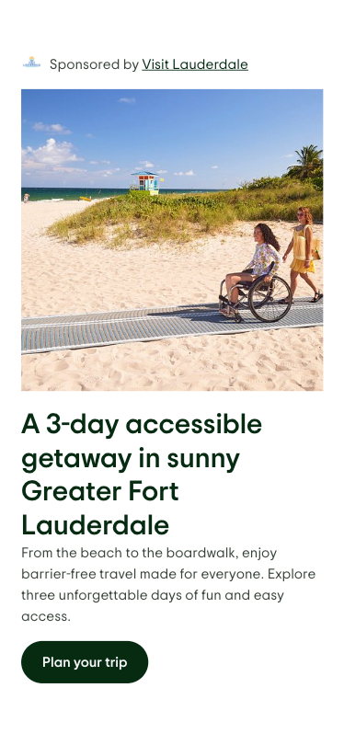

Partnerships
Scan to visit our accessible travel hub

Slide 15
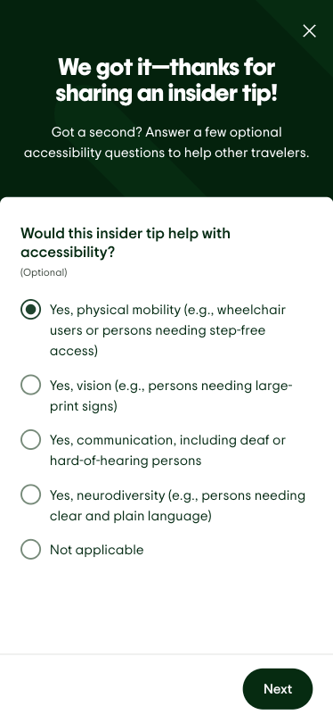
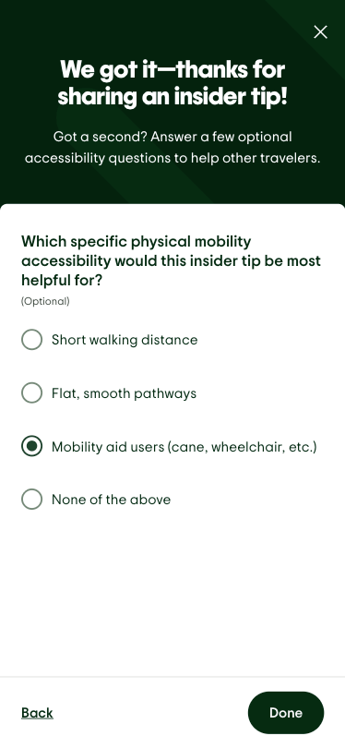
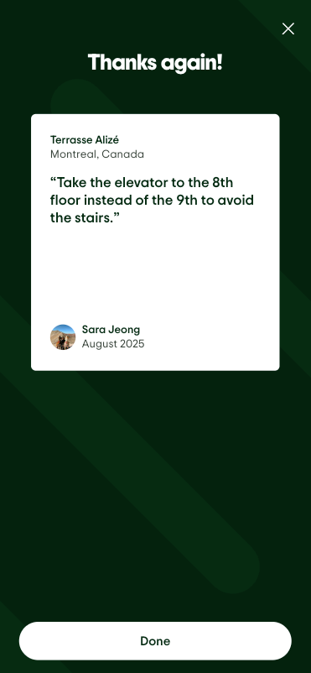
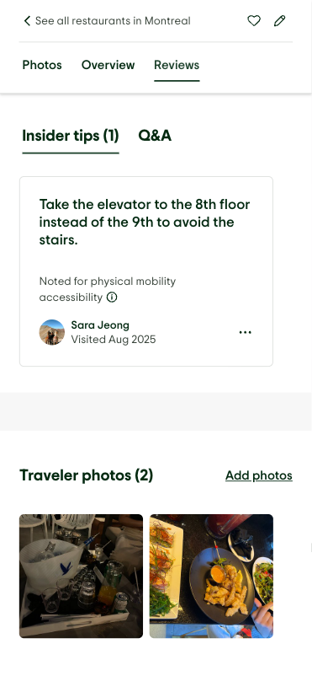
Insider Tips

Slide 16
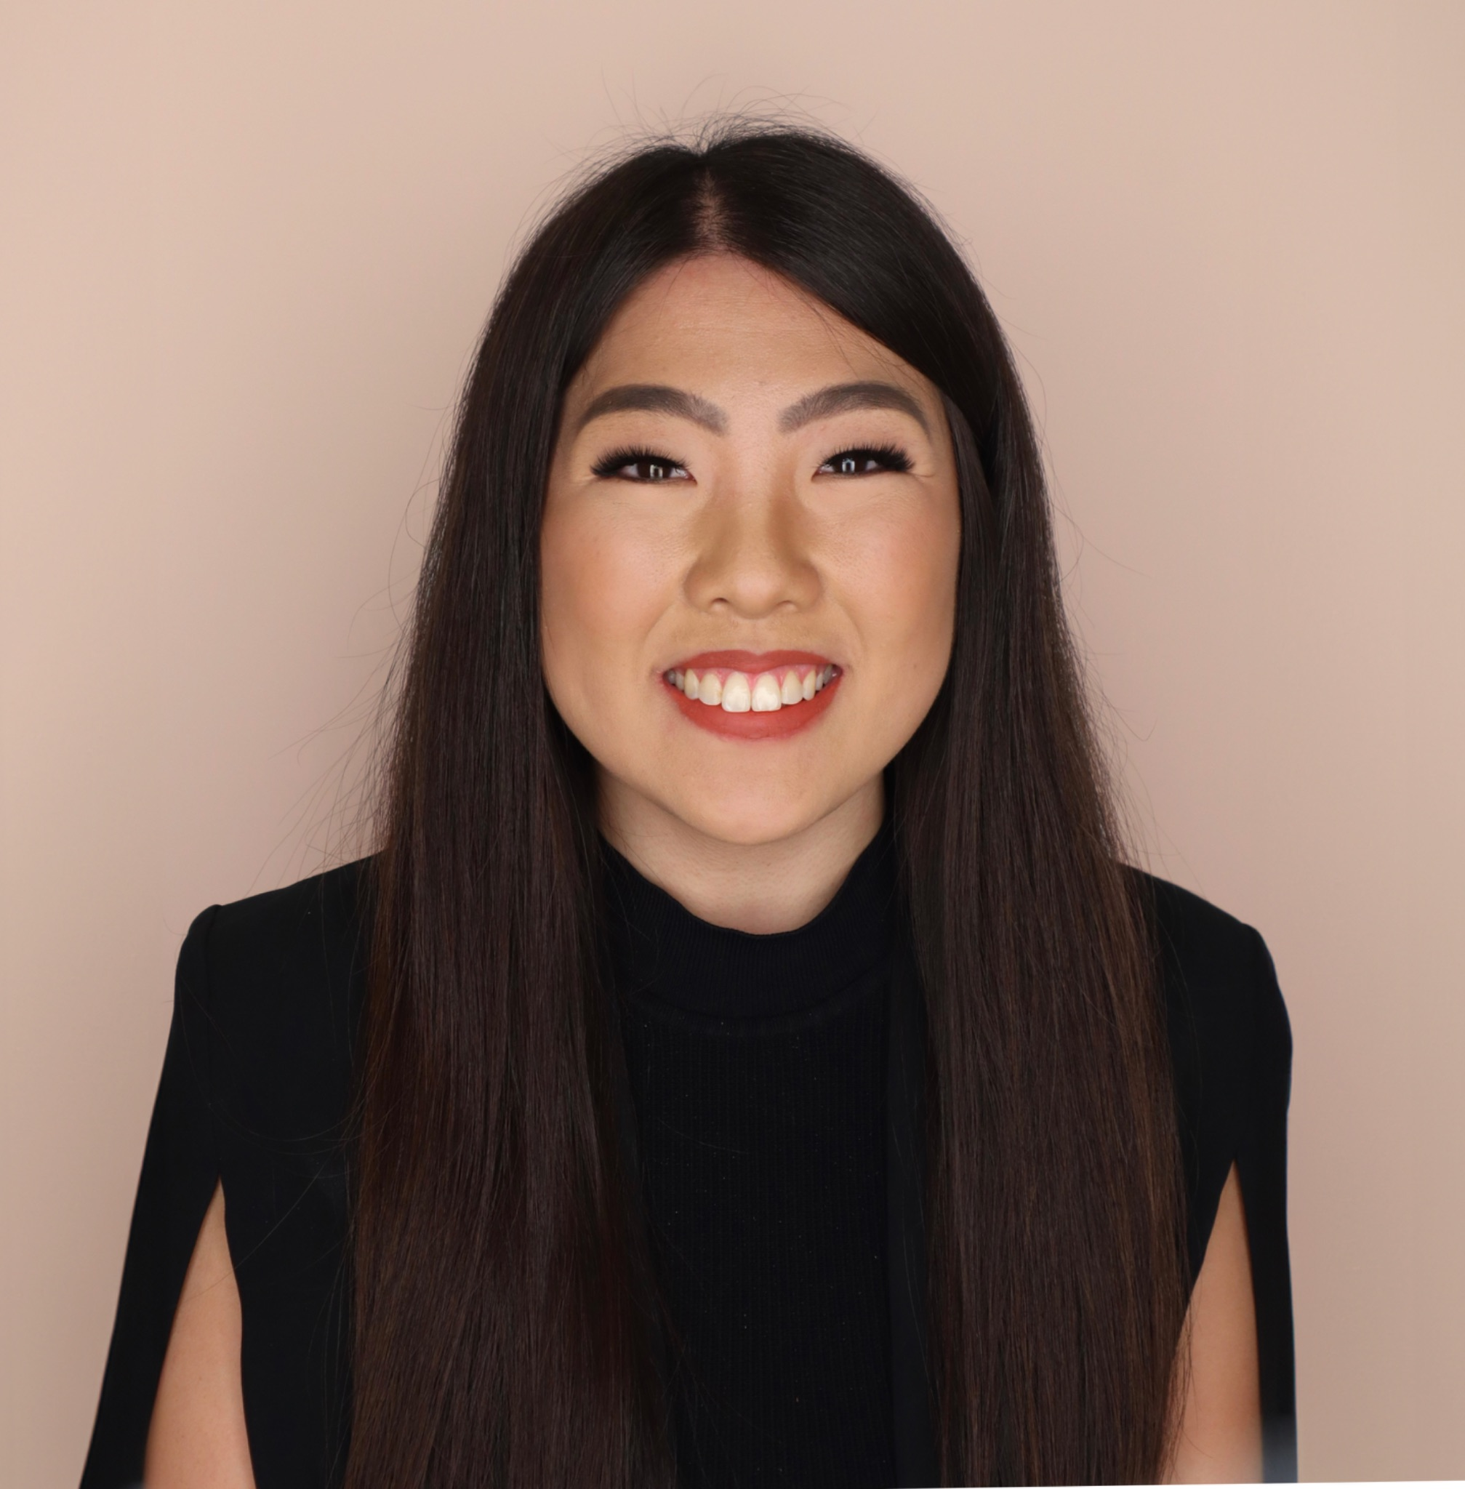
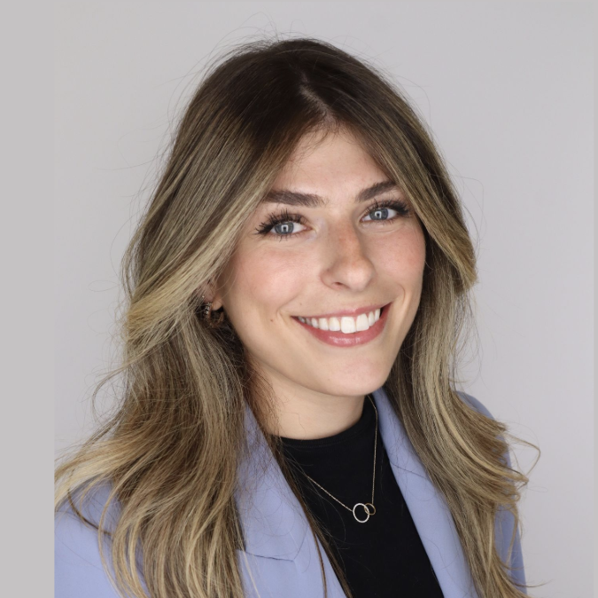
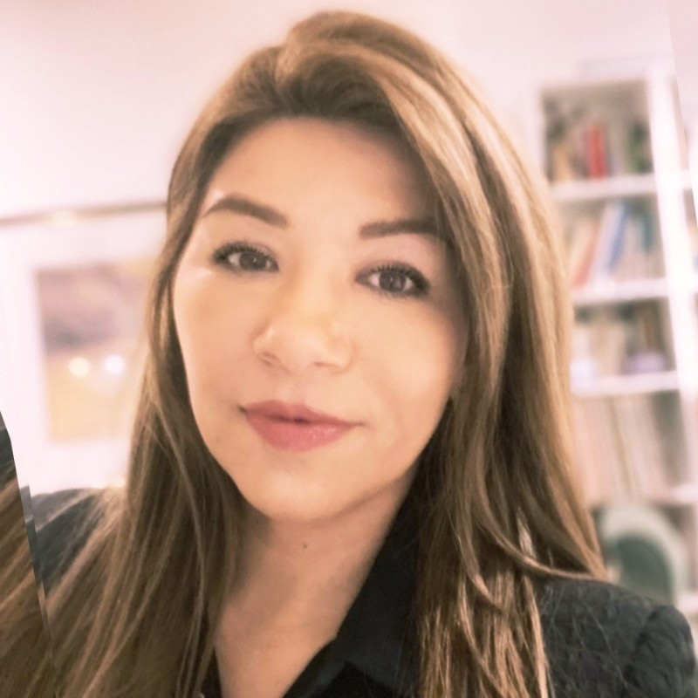
Let’s connect
Sara Jeong
Co-Lead Empowered@
sjeong@tripadvisor.com
Veronica Tsvok
Co-Lead Empowered@
vtsvok@tripadvisor.com
Milen Rendon
Co-Lead Empowered@
mrendon@tripadvisor.com

Slide 17

Unseen, Not Unsupported: Accommodating Employees with Chronic Illness and Non-Apparent Disabilities
Panelists:
Rachel Durgin, Supply Chain Manager and CapAbilities BRG Leader, Capital One
Na Shai Glover, Director, Belonging & Inclusive Experiences, Elevance Health
Leah Brome, Director, Kinship @ Kyndryl, Kyndryl
Moderator:
Sarah Kirwan, Corporate Disability Inclusion Consultant, Disability:IN

Slide 18
INsider Summit Housekeeping – Panel 1
Session Help
All attendee microphones are muted.
Use the Q&A feature to communicate with Disability:IN or presenters.
You may need to reboot your computer or try logging out & back in to resolve any technical issues.
CART
English captions are available on-screen.
Captioning in additional languages available via StreamText link provided in the meeting materials.
ASL Interpretation
American Sign Language is provided on screen.
Asking Questions
Q&A will be available in the panel sessions.
Due to timing and the number of participants, we may not be able to answer all questions.
Reach out to your IW Consultant if needed.
Session Recordings
Sessions are being recorded.
An email will be sent with access and viewing instructions after the summit.
New! SHRM Credits
SHRM recertification credits are approved for this event.
To receive credit, attend each session live and fill out the feedback survey which will be sent after each day of the Summit.

Slide 19

Take a Break! We’ll return at 12:00 PM ET

Slide 20

Shift by Shift: What it Takes to Create Accessible Workplaces for Hourly Employees
Panelists:
Dario Mantegazza, Chief Additive Manufacturing Engineer and Regional Operating Leader for Disability Advocacy Network, GE Aerospace
Simone Wilder, Manufacturing Supervisor, Novartis
Patricia O'Rourke, Senior Director of Distribution, Tiffany & Co.
Moderator:
Derek Shields, Corporate Disability Inclusion Consultant, Disability:IN

Slide 21
INsider Summit Housekeeping – Panel 2
Session Help
All attendee microphones are muted.
Use the Q&A feature to communicate with Disability:IN or presenters.
You may need to reboot your computer or try logging out & back in to resolve any technical issues.
CART
English captions are available on-screen.
Captioning in additional languages available via StreamText link provided in the meeting materials.
ASL Interpretation
American Sign Language is provided on screen.
Asking Questions
Q&A will be available in the panel sessions.
Due to timing and the number of participants, we may not be able to answer all questions.
Reach out to your IW Consultant if needed.
Session Recordings
Sessions are being recorded.
An email will be sent with access and viewing instructions after the summit.
New! SHRM Credits
SHRM recertification credits are approved for this event.
To receive credit, attend each session live and fill out the feedback survey which will be sent after each day of the Summit.

Slide 22

Space to Breathe: Building and Managing Sensory Rooms that Work
Panelists:
Cornel Hrisca-Munn, Vice President, Accessibility, BlackRock
Lee-Jung Kim, Design and Change Management Lead, Work Experience Team, Pfizer
Gayatri Agnew, Global Associate Experience and Head of Accessibility Center of Excellence, Walmart
Moderator:
Deb Dagit, Corporate Disability Inclusion Consultant, Disability:IN

Slide 23
INsider Summit Housekeeping – Panel 3
Session Help
All attendee microphones are muted.
Use the Q&A feature to communicate with Disability:IN or presenters.
You may need to reboot your computer or try logging out & back in to resolve any technical issues.
CART
English captions are available on-screen.
Captioning in additional languages available via StreamText link provided in the meeting materials.
ASL Interpretation
American Sign Language is provided on screen.
Asking Questions
Q&A will be available in the panel sessions.
Due to timing and the number of participants, we may not be able to answer all questions.
Reach out to your IW Consultant if needed.
Session Recordings
Sessions are being recorded.
An email will be sent with access and viewing instructions after the summit.
New! SHRM Credits
SHRM recertification credits are approved for this event.
To receive credit, attend each session live and fill out the feedback survey which will be sent after each day of the Summit.

Slide 24


Before You Go…
How was today’s INsider Summit experience?
Please give us your feedback!
Scan the QR code below or access the survey link.

Slide 25

See You in July!

