Slide 1


Welcome!
Inclusion Works INsider Summit
February 2026

Slide 2






INsider Summit Housekeeping
Session Help
All attendee microphones are muted.
Use the Q&A feature to communicate with Disability:IN or presenters.
You may need to reboot your computer or try logging out & back in to resolve any technical issues.
CART
English captions are available on-screen.
Captioning in additional languages available via StreamText link provided in the meeting materials.
ASL Interpretation
American Sign Language is provided on screen.
Asking Questions
Q&A will be available in the panel sessions.
Due to timing and the number of participants, we may not be able to answer all questions.
Reach out to your IW Consultant if needed.
Session Recordings
Sessions are being recorded.
An email will be sent with access and viewing instructions after the summit.
New! SHRM Credits
SHRM recertification credits are approved for this event.
To receive credit, attend each session live and fill out the feedback survey which will be sent after each day of the Summit.

Slide 3

Jill Houghton President & CEO, Disability:IN

Slide 4



2026 Disability:IN Global Conference & Expo
July 27-30 | Dallas
For Builders, Investors, and Leaders Shaping the Future of Business.
Join us for the INsider Summit on July 27 to continue the conversation.
Notes:
Register: https://disabilityin.org/conference?utm_source=presentation&utm_medium=partners&utm_campaign=2026_conference_launch

Slide 5




Turn Insights Into Action
The Disability Index is more than just a survey.
It’s a strategic business resource that helps companies evaluate organizational maturity and identify gaps that have real business implications.
Register and view answers to our most-asked questions here.
Questions? Oli’s got answers.
Our concierge support agent offers 24/7 assistance. Find Oli in the lower left corner of the Disability:IN website.
Notes:
Register: https://bit.ly/3YXk61E
Participation Guide: https://disabilityin.org/resource/the-disability-index-participation-guide?utm_source=presentation&utm_medium=partners&utm_campaign=2026_index_launch
Office Hours: https://disabilityin.org/events-calendar?utm_source=presentation&utm_medium=partners&utm_campaign=2026_index_launch

Slide 6




Today’s Agenda Tuesday, February 17
10:00 Opening Keynote: Disability Inclusion & Social Capital in the Workforce: An Overview of LinkedIn’s Most Recent Reports on Disability Professional Networks and Career Mobility
10:45 Snapshots in Global Disability Hiring
12:00 The Power of Representation: Disability- Inclusive Marketing that Moves People
1:00 The Next Chapter: Evolving Disability ERGs
*all times EST

Slide 7

Opening Keynote
Disability Inclusion & Social Capital in the Workforce: An Overview of LinkedIn’s Most Recent Reports on Disability Professional Networks and Career Mobility
Matthew Baird, Ph. D, Senior Staff Economist, LinkedIn
Moderator:
Reid Jewett Smith, Ph. D, Vice President, Policy & Research, Disability:IN

Slide 8

Disability Status and Networks

Slide 9
Research Findings
connection closeness
information value
network size
weak ties

Slide 10

Momentum at Work

Slide 11

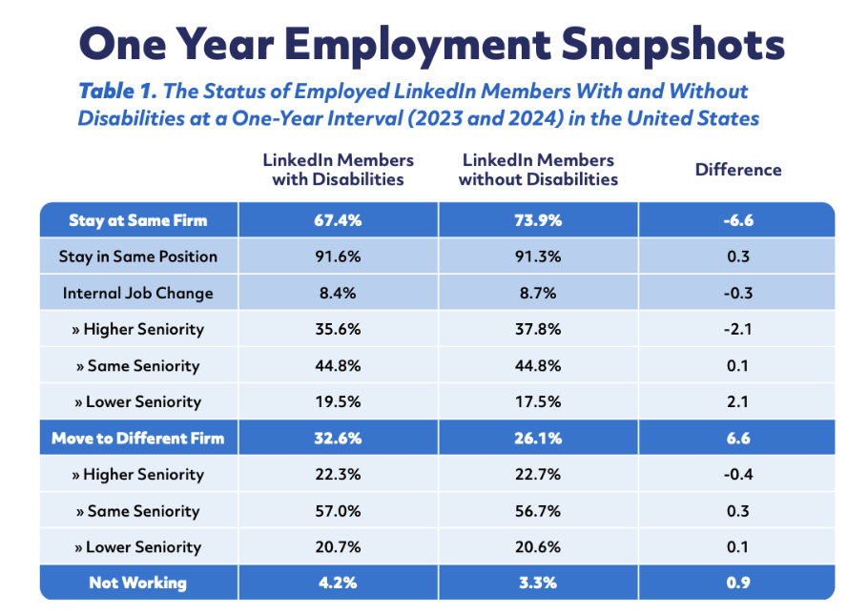
One Year Employment Snapshots

Slide 12
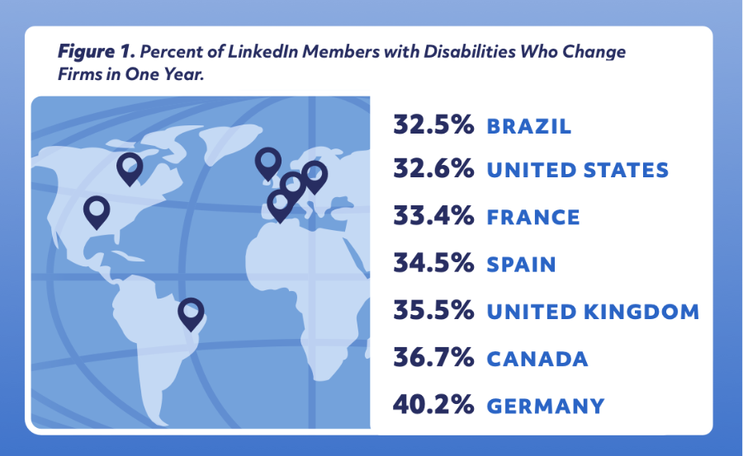
Global Research Findings

Slide 13
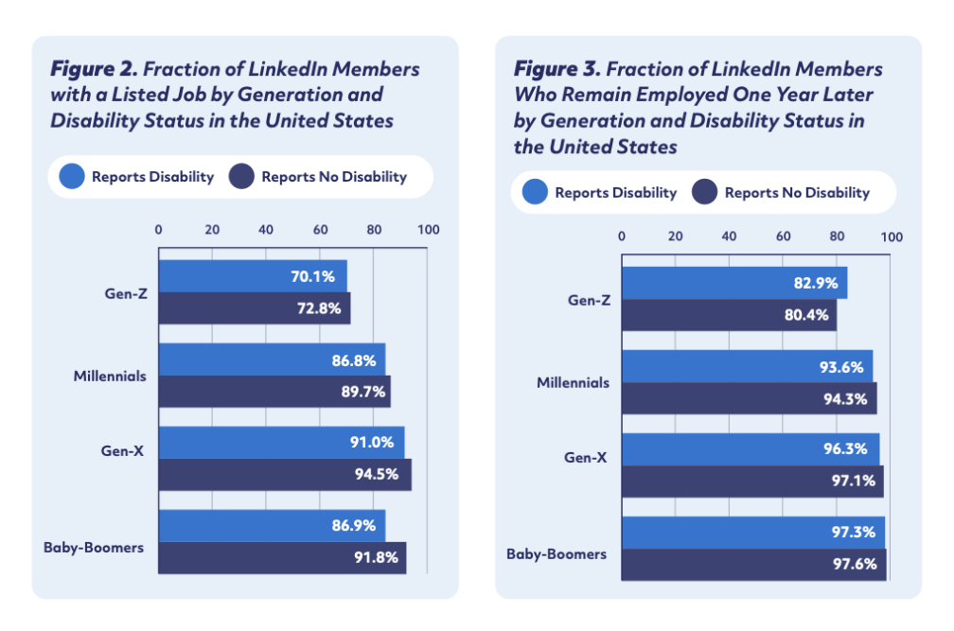
Generation, Disability Status, and Employment

Slide 14

Snapshots in Global Disability Hiring
Panelists:
Chaya Mangesh, Head of Talent Acquisition, Specialty Recruiting, Amazon
Teodora Aleksandrova, Senior Director DEI & Talent Strategy, Adidas
Ana Aleixo, Regional Director, Global Inclusion, Scotiabank
Moderator:
Joan Bohan, Corporate Disability Inclusion Consultant, Disability:IN

Slide 15
INsider Summit Housekeeping - Session 1
Session Help
All attendee microphones are muted.
Use the Q&A feature to communicate with Disability:IN or presenters.
You may need to reboot your computer or try logging out & back in to resolve any technical issues.
CART
English captions are available on-screen.
Captioning in additional languages available via StreamText link provided in the meeting materials.
ASL Interpretation
American Sign Language is provided on screen.
Asking Questions
Q&A will be available in the panel sessions.
Due to timing and the number of participants, we may not be able to answer all questions.
Reach out to your IW Consultant if needed.
Session Recordings
Sessions are being recorded.
An email will be sent with access and viewing instructions after the summit.
New! SHRM Credits
SHRM recertification credits are approved for this event.
To receive credit, attend each session live and fill out the feedback survey which will be sent after each day of the Summit.

Slide 16
Take a Break! We’ll return at 12:00 PM ET

Slide 17
The Power of Representation: Disability-Inclusive Marketing that Moves People
Panelists:
Sarah Hodges, Chief Marketing Officer, UKG
Juneen Kirk, SVP, Customer Experience, Workplace Marketing & Commercial Expansion, Voya Financial
Moderator:
Allyce Torres, Sr. Director, Marketing & Communications, Disability:IN

Slide 18
INsider Summit Housekeeping - Session 2
Session Help
All attendee microphones are muted.
Use the Q&A feature to communicate with Disability:IN or presenters.
You may need to reboot your computer or try logging out & back in to resolve any technical issues.
CART
English captions are available on-screen.
Captioning in additional languages available via StreamText link provided in the meeting materials.
ASL Interpretation
American Sign Language is provided on screen.
Asking Questions
Q&A will be available in the panel sessions.
Due to timing and the number of participants, we may not be able to answer all questions.
Reach out to your IW Consultant if needed.
Session Recordings
Sessions are being recorded.
An email will be sent with access and viewing instructions after the summit.
New! SHRM Credits
SHRM recertification credits are approved for this event.
To receive credit, attend each session live and fill out the feedback survey which will be sent after each day of the Summit.

Slide 19

The Next Chapter: Evolving Disability ERGs
Panelists:
Caitlin Rose, Director, People Services, US, BASF Corporation
Brian DeMartino, Global HR Advisory Services Manager, Bechtel
Christopher Cardarelli, Executive Director, Human Resources, Merck
Moderator:
Michelle Maybaum, Corporate Disability Inclusion Consultant, Disability:IN

Slide 20
INsider Summit Housekeeping - Session 3
Session Help
All attendee microphones are muted.
Use the Q&A feature to communicate with Disability:IN or presenters.
You may need to reboot your computer or try logging out & back in to resolve any technical issues.
CART
English captions are available on-screen.
Captioning in additional languages available via StreamText link provided in the meeting materials.
ASL Interpretation
American Sign Language is provided on screen.
Asking Questions
Q&A will be available in the panel sessions.
Due to timing and the number of participants, we may not be able to answer all questions.
Reach out to your IW Consultant if needed.
Session Recordings
Sessions are being recorded.
An email will be sent with access and viewing instructions after the summit.
New! SHRM Credits
SHRM recertification credits are approved for this event.
To receive credit, attend each session live and fill out the feedback survey which will be sent after each day of the Summit.

Slide 21


Before You Go…
How was today’s INsider Summit experience?
Please give us your feedback!
Scan the QR code below or access the survey link.

Slide 22

See You Tomorrow!

