Slide 1


Welcome
Corporate Community of Progress Meeting
February 2025

Slide 2






Conference Housekeeping
Session Help
All attendee microphones are muted.
Use the Q&A feature to communicate with Disability:IN or presenters.
You may need to reboot your computer or try logging out & back in to resolve any technical issues.
CART
English captions are available on-screen.
Captioning in additional languages available via StreamText link provided in the meeting materials.
ASL Interpretation
American Sign Language is provided on screen.
Asking Questions
Q&A will be available in the panel sessions, starting at 10:30 ET.
Session Recordings
Sessions are being recorded.
An email will be sent with access and viewing instructions after the conference.

Slide 3



Advancing disability inclusion in business.

Slide 4
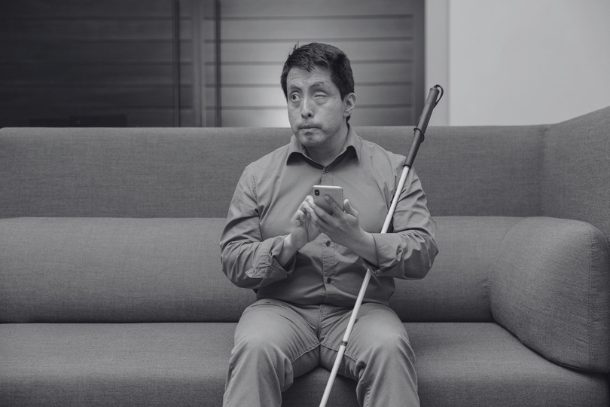
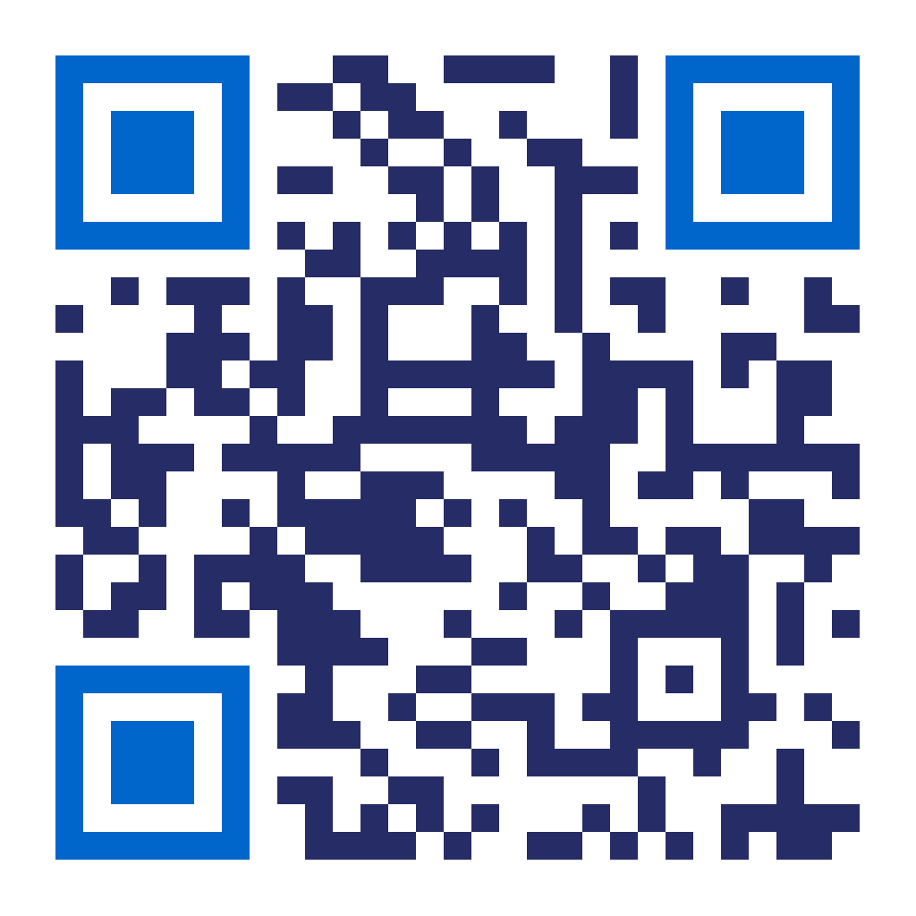


Join IN
Data & Messaging Guide
Making the Business Case for Disability Inclusion & Accessibility. (Messaging Guide, PDF)
Industry Literature Review on the Business Case for Disability Inclusion (PDF)
Legal Insights
Guide to Legal Foundations for Disability Inclusive Employment (Document).
Exclusive Webinar
Register for the March 12th webinar here. (Form)

Slide 5
A Competitive Advantage
Companies that lead in disability inclusion achieve:
2.6x
2x
+1.3 BILLION
More Net Income
people with disabilities worldwide
More Economic Profit
1.6x
+$13 TRILLION
More Revenue
in disposable income across the global disability market
80%
of consumers are more likely to buy from a company committed to disability inclusion.
Notes:
1.6% higher revenue, 2.6x net income, 2x higher economic profit, 25% more productivity (measured as revenue/employee). [Accenture & Disability:IN, The Disability Inclusion Imperative]
80% of consumers are more likely to buy from a company committed to disability inclusion. [Voya, Institute for Public Relations]
People with disabilities control an estimated $13 trillion annually in discretionary income. [WEF]
1.3 billion people with disabilities worldwide, about 16% of the world’s population. [World Health Organization]

Slide 6

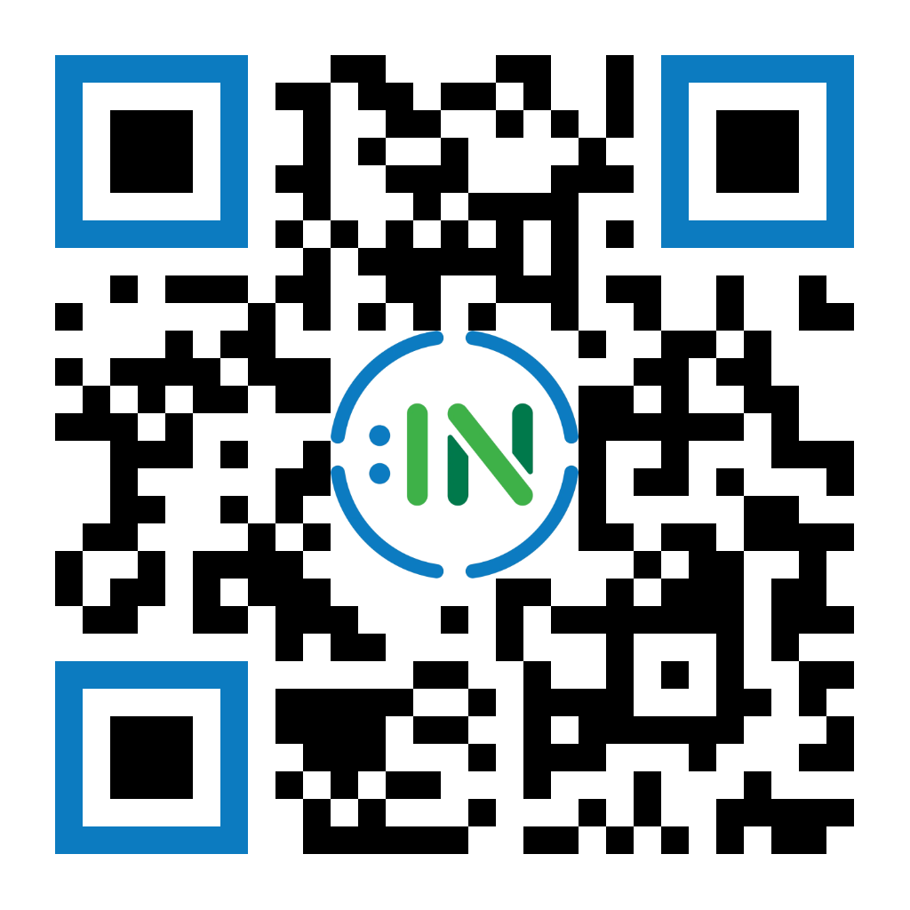

Your Input Matters!
We’re here to support you—tell us what research, resources, and insights will help you most!
Click to Fill Out the Form

Slide 7
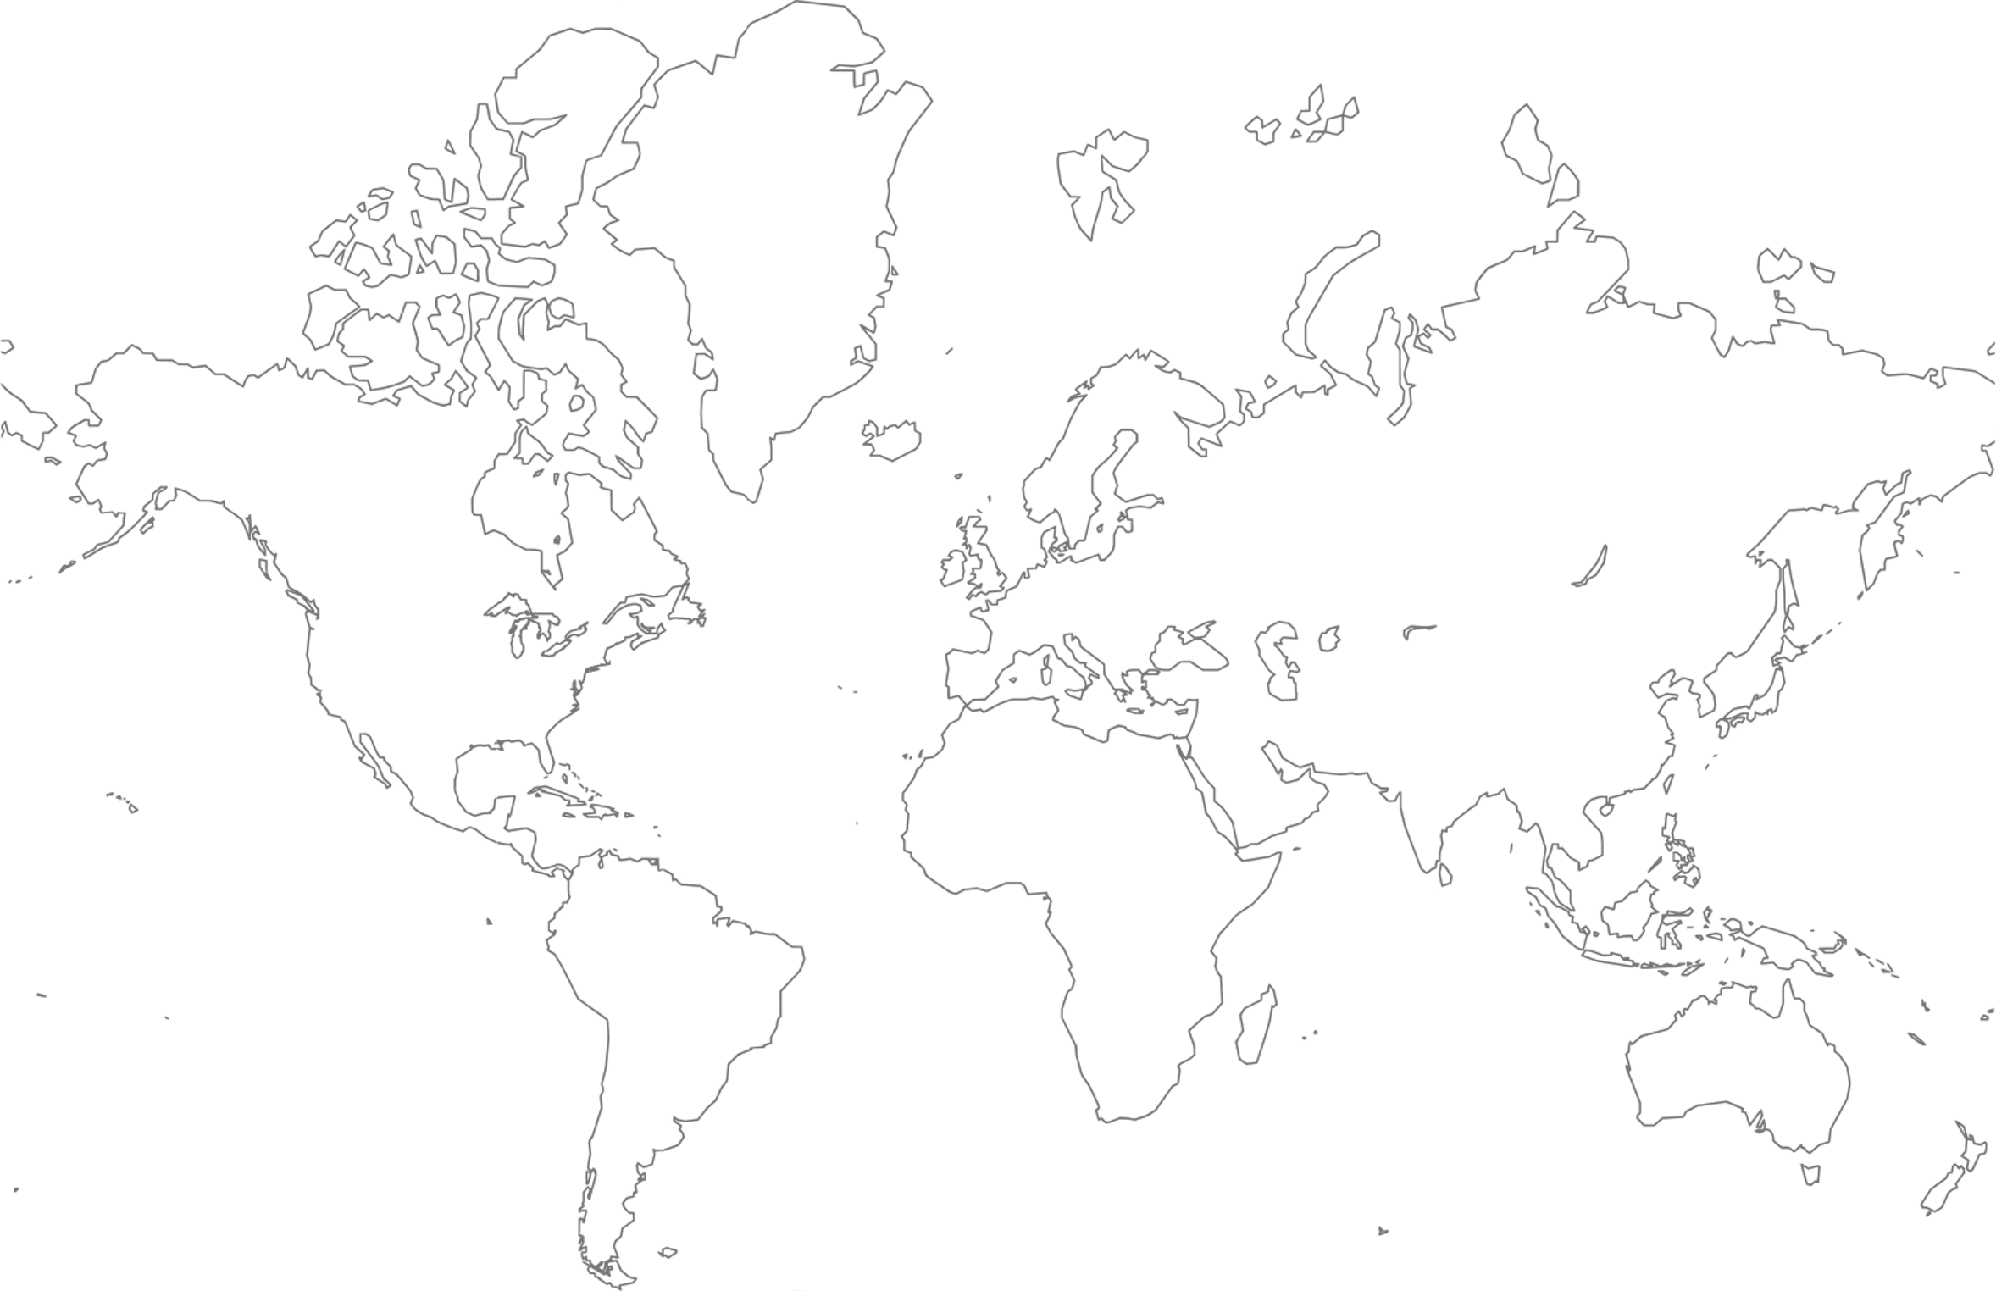
Upcoming Global Events
14-17 JUL.
MAY
ORLANDO
EUROPE
The 2025 Disability:IN Global Conference is the corporate disability inclusion event of the year. Attendees gain access to cutting-edge session content, enhanced networking and recruiting, and high-profile speakers.
Business Roundtables in five European cities including Paris, London, Brussels, Berlin, and Frankfurt. Discussion will include an overview of the EU’s legislative initiatives and a digital accessibility workshop featuring corporate case studies.
MAR.- SEPT.
18-20 NOV.
LATAM
BENGALURU
Webinars featuring corporate leaders across Latin America on topics such as disability etiquette, neurodiversity, and attracting talent with disabilities.
The APAC Global Journey to Disability Inclusion in Business is a three-day in -person event that will include networking, best practice sharing, and a recruiting and retention summit.
Plus, bi-monthly webinars, Global Accessibility Awareness Day programming, and more!

Slide 8
Inclusion Works Update

Slide 9
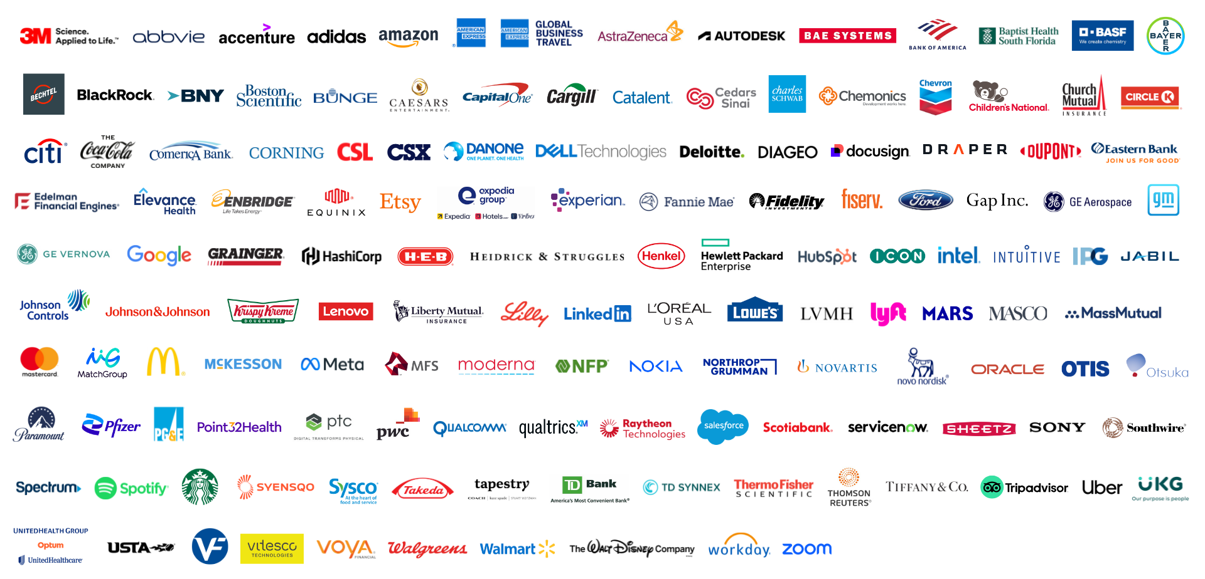
2025 Inclusion Works Participating Companies

Slide 10
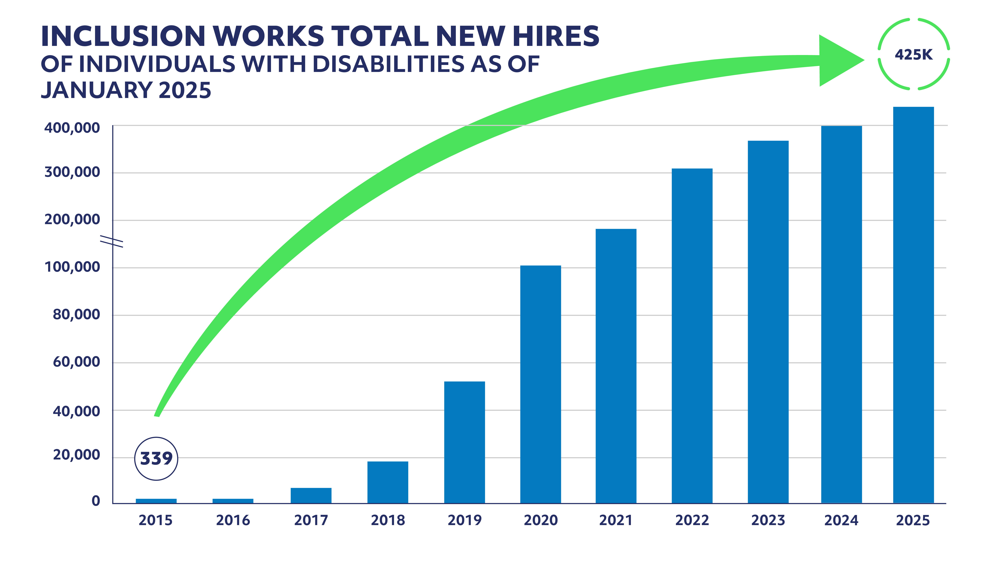

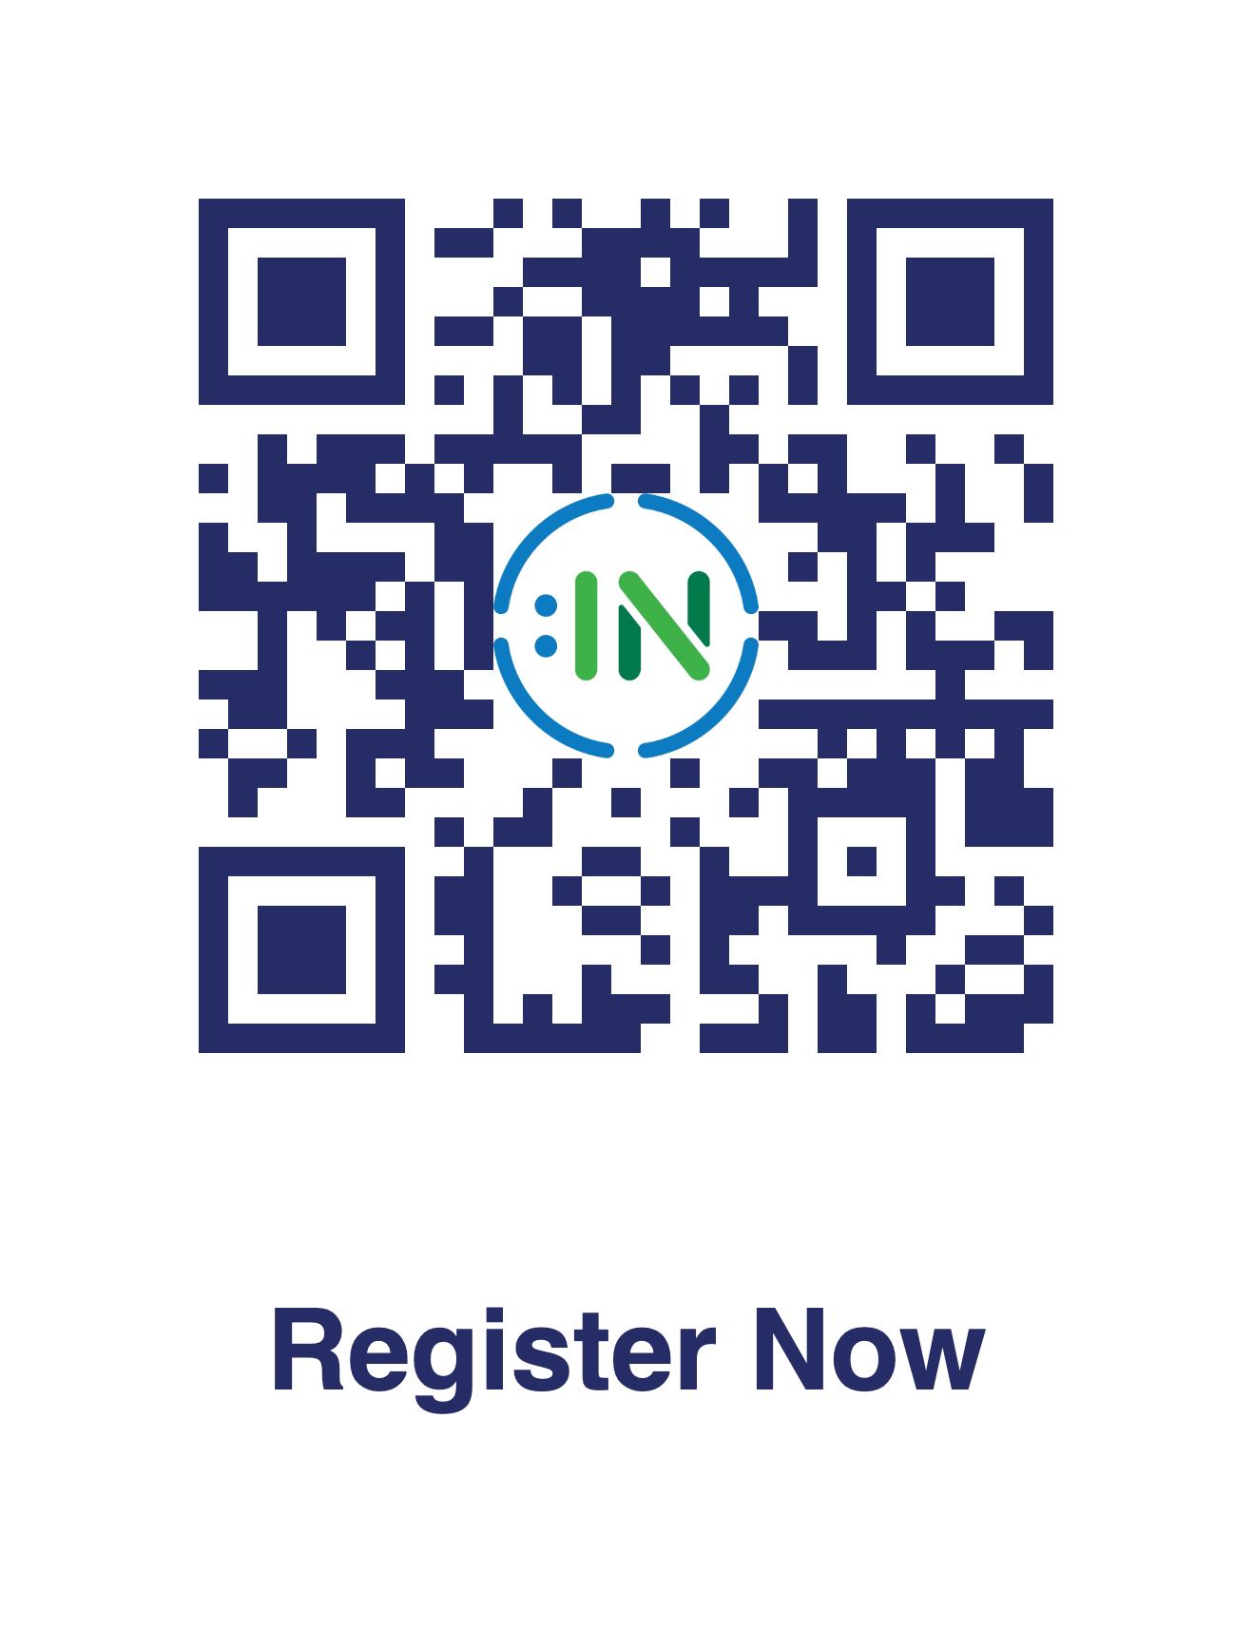
Celebrating Your Success!
91
+20
IW Companies scored an average of 91 on the 2024 Disability Index
…and improved their Disability Index score by an average of 20 points!
Inclusion Works companies have hired over 425,000 new employees with disabilities since 2015!
Register Your Company TODAY!
2025

Slide 11

Let Us Help You Recruit Disabled Talent!
Tech Industry Virtual Showcase
Session 1: May 14, 2025
Session 2: May 21, 2025
Registration: March 3, 2025 – April 14, 2025
The objective of the Tech Industry Showcase is to provide Inclusion Works companies with tech roles an opportunity to present a high-level overview of your company's culture & available opportunities.
You will receive access to candidate resumes before the event to source talent for pre-scheduled 15 min interviews in your company’s private virtual interview room.
Target Candidate Audience: Veterans and candidates with disabilities who are entry-level, mid-level and experienced, seeking opportunities within the participating companies and/or with technical backgrounds.
Space is limited!
Contact Bridgette Anderson Bridgette@disabilityin.org or your IW consultant to learn more and register!

Slide 12

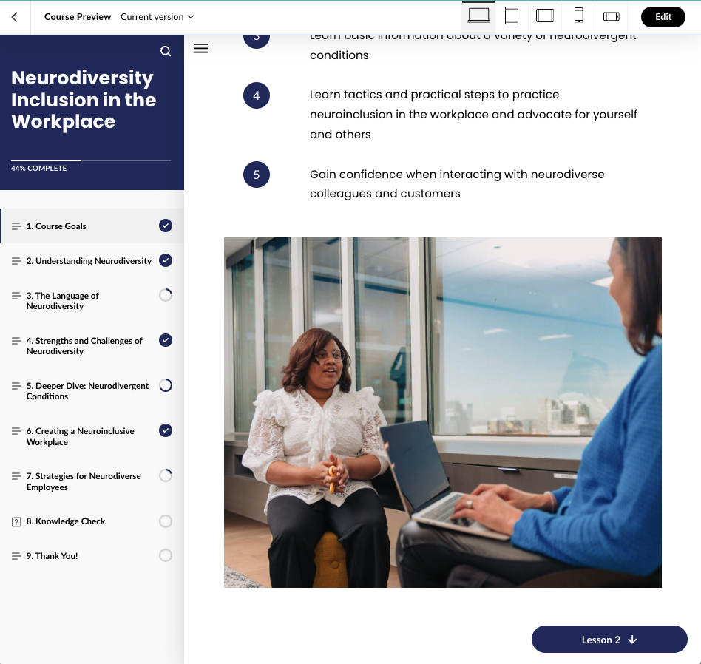
Have you seen our eLearning courses?
Exclusive to Inclusion Works!
Accessible, mobile-friendly eLearning courses on disability inclusion topics
…more to come in 2025
Find our eLearning courses and other learning resources in the Inclusion Works Library (password Works2024)

Slide 13

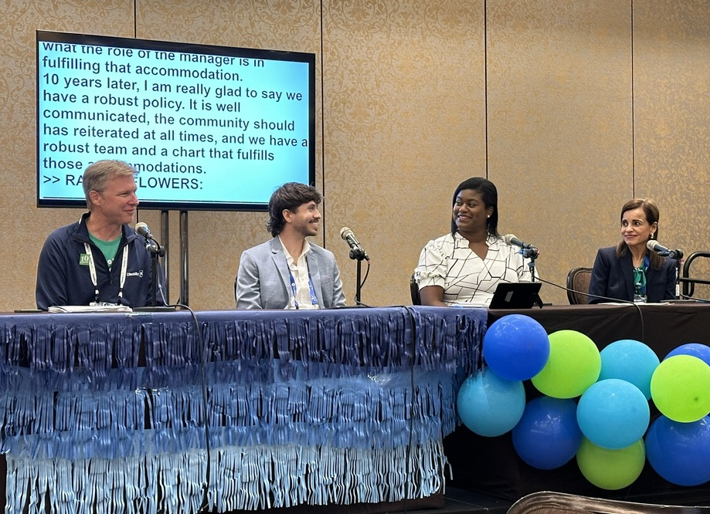
What’s Next for Inclusion Works? Inclusion Works Meeting Monday, July 14, 2025 Streamed & In-Person at The Gaylord Palms Resort & Convention Center, Orlando, Florida No limit on attendees from your company – 500+ seats & no cost to participate. We want to hear from you. What would you like to learn? Reach out to Cara Pelletier: Cara@DisabilityIN.org
UPDATE. Include pic from Vegas

Slide 14


2025 Global Conference!
Save the Date! July 14-17, 2025
Join us in Orlando, FL for the disability inclusion event of the year!
Cutting-edge educational sessions, enhanced networking and recruiting, and high-profile speakers
In-person and live-streaming options available
Learn more about the conference

Slide 15
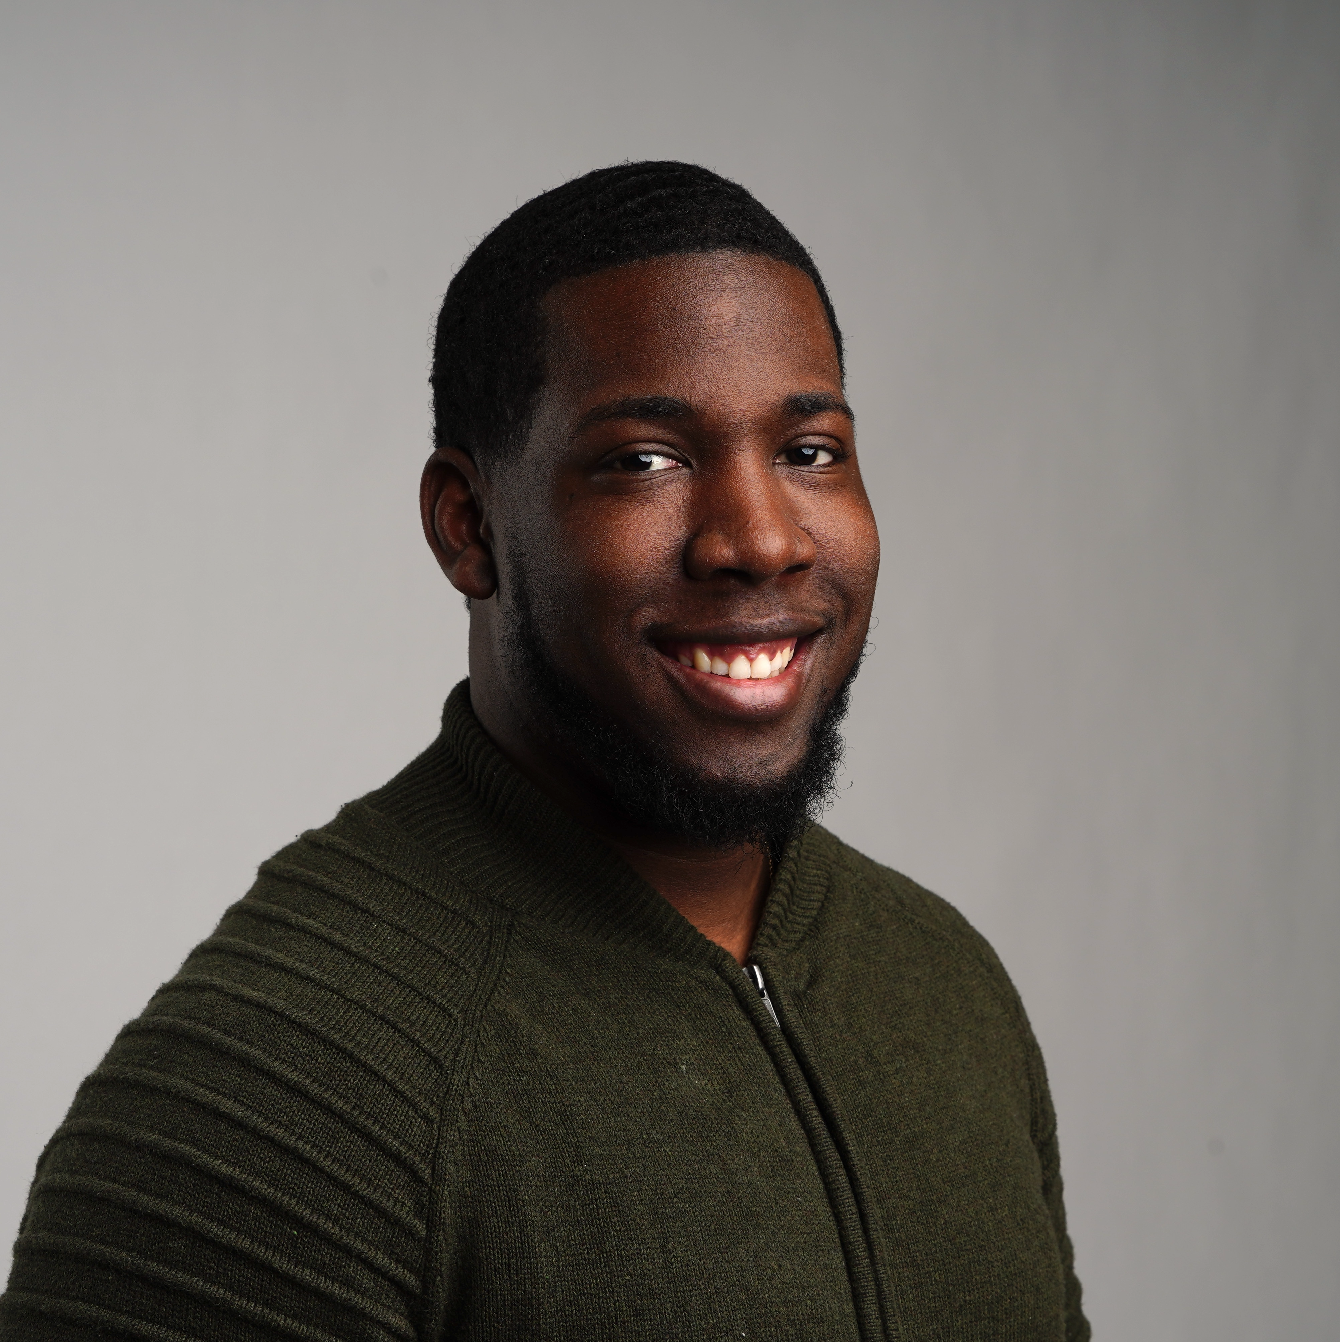
Keynote1
From Overwhelmed to Empowered: Setting Boundaries for Healthy Employees, Leaders, and Organizations
Keynote Speaker: Jon McLeod, Multimedia Producer & ESPN TRUST Co-Founder/Co-Chair (All Things Mental Health for ESPN)
Host: Cara Pelletier, Vice President, Inclusion Works, Disability:IN

Slide 16
Who Am I…?
Husband
Father
Son
Brother
Leader
Business Owner
Public Speaker
Mental Health Advocate and Community Leader
Multimedia Producer
Career and Life Coach
REI Investor
Social Media Influencer
Pray for me!

Slide 17

The Concept: Creating Boundaries is a Core Part of Life
What is a Boundary?
Boundaries are socially constructed distinctions between different domains of life.
A.K.A. YOUR rules for anyone interacting with you.
Family
Friends
Co-workers
Bosses
No Rules = No Boundaries

Slide 18
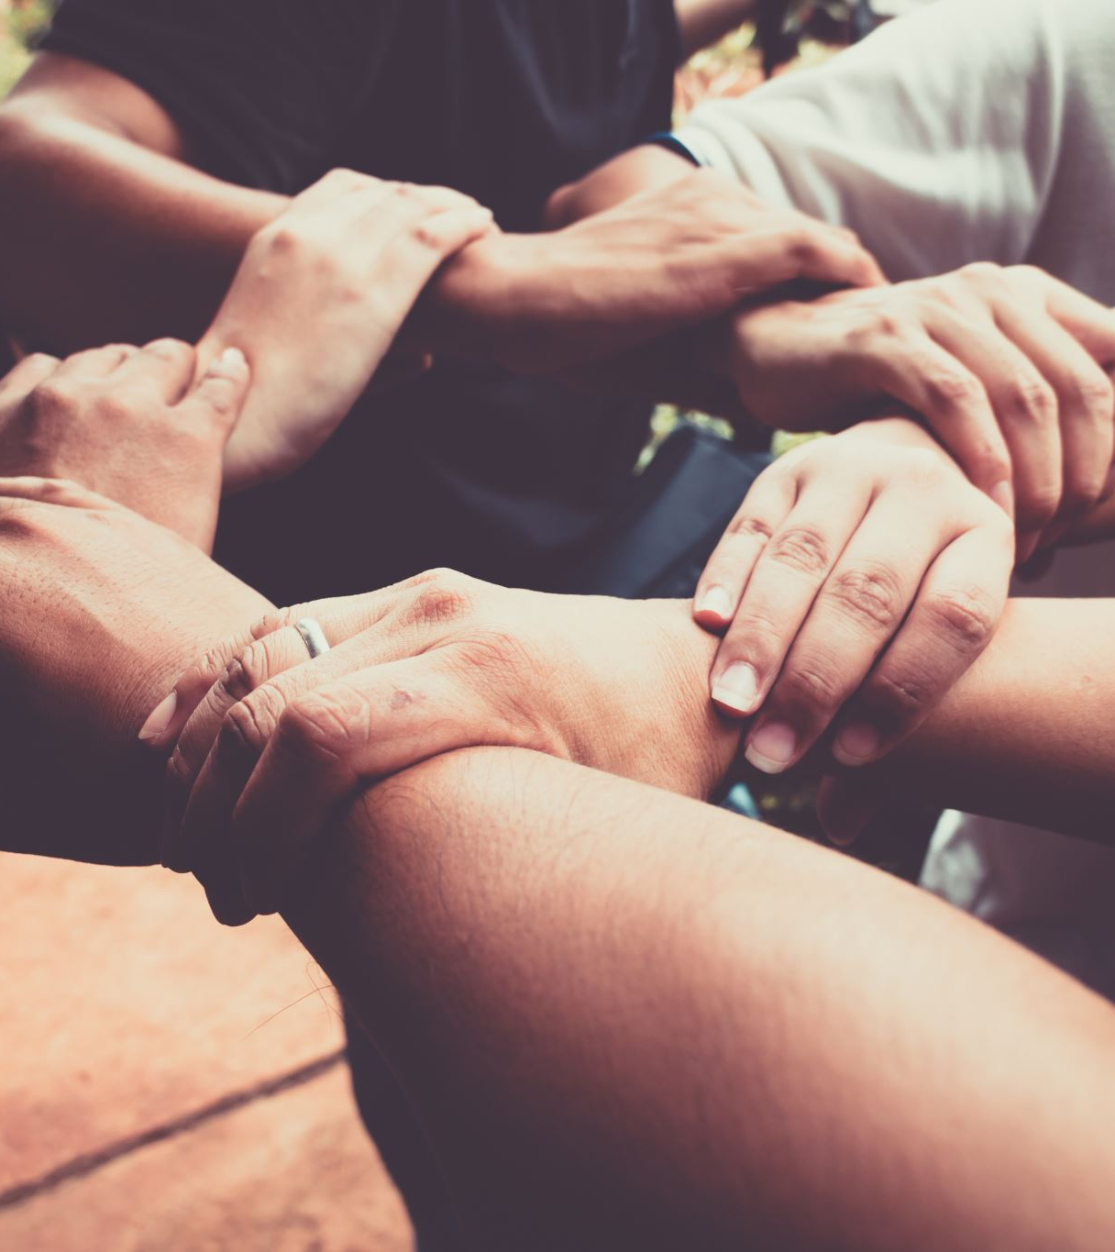
Top 2 Reasons Boundaries are Broken
Miscommunication or NO Communication
What the opposing individual understood vs. what was requested or explained.
Disagreement
The opposing person understood but has primary and/or fundamental beliefs that inhibit their ability to respect the requested boundary.

Slide 19

How do we fix or prevent Boundary Breaking?
Tactic 1: Effective Communication
The world finds out what you’re thinking when YOU speak!
Silence shatters Boundaries!
The Fix Framework:
Who is this person that’s crossing my boundary and what’s our relationship?
What boundary did they cross?
Did I communicate?
If yes, what did I say?
If no, then communicate directly.
What was their reaction to my communication?
Follow up communication: gain or give clarity to reinforce the boundary

Slide 20

How do we fix or prevent Boundary Breaking? (2 of 2)
Tactic 2: Time Control
Control your Time = Control Your Boundaries
We can feel most overwhelmed when we feel out of control of our day.
“Life” pulls us in the direction of our “responsibilities”
Family Tasks
Work Tasks
Friend Tasks
Leader Tasks
The Fix Framework:
Manage your calendar by the MOST IMPORTANT task NOT the first task
Know your “Un-movable’s” (Tasks that HAVE to get done)
Ask “SHOULD I be doing this right now?”
“Who can help me do this?” – Asking this can prevent burnout and anxiety
Include YOU on your calendar!!!!

Slide 21
Exercise: Make Tomorrow Better than Today!
Make a list of the activities that make you happy.
Make a list of the MOST important responsibilities you handle (Family and Work tasks included together).
Pull your calendar out & check your week
Determine when (time) you start your day.
Identify what you’re going to do for YOU first.
Block that on the calendar.
Block the MOST important work task for the day.
Can you adjust any pre-existing meetings to fit in some self-care? (15-minute walk, 10-minute-deep breathing meditation, etc.)
Repeat the process each week.

Slide 22

Thank You – End of Session
Thank You!
Want to chat or need help?
Connect with me on LinkedIn: Jon McLeod

